Slide 1
Welcome To My Presentation

Slide 2
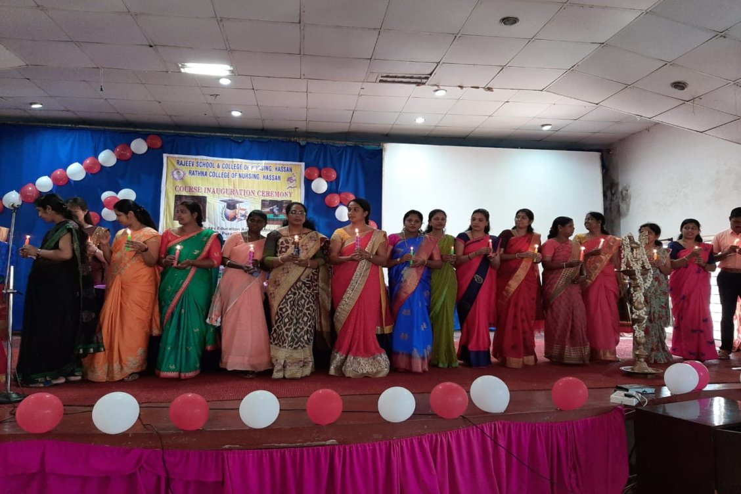
C.2 ) Annual Day of My College and Perform

Slide 3
The annual function of any college or school is the day when all Teaching and Non-Teaching staff of school students and college management gather under one roof to celebrate the achievement of the School or College. The following article is about the Anchoring
Anchor 1: Good Evening Today’s day is going to be the most memorable day of your life. I (anchor 1 name ) Welcome you to this wonderful event along with my co-host (anchor 2 name).
Anchor 2: Today we will be Celebrating, Remembering, Acknowledging, and Admiring the achievement of our institution. So sit back and relax because this is going to be the most amazing experience of your life.
Anchor 1: Honorable Chief Guest Mr. Srikant Gaikwad. Respected Principal madam, Respected Teaching and non-teaching staff, and my dear student. I (anchor 1 name) Take pride in standing before you and speaking of the occasion of (annual function name) of our school.

Slide 4
As I told you this will be the most memorable event of your life. All this would have not been possible without the presence of such a great audience thank you all for attending today evening and making this event extra special. I will also like to thank our chief guest and principal madam for giving their valuable time to us.
I will also like to thank the students who organize this event with proper planning and executing it with excellence. And last but certainly not least parents thanks for coming here we express our gratitude to our parents because without their support we are nothing.
Thank you for coming. Hope we will maintain this relationship of excellence and perfection for ages to come. Good night buddies
Starting lines are most IMP when you are anchoring here are some – Starting lines for anchoring
and also some more – Anchoring script for school assembly

Slide 5
Anchor 1: Now please give a Big hand to girls who are going to sing a Swagat geet. (Girls singing Swagat geet)
Anchor 2: What a heart-touching performance by girls please have a round of applause for them.
Anchor 1: Now I request Principal madam to Welcome the Honorable chief guest.
Anchor 2:I requests Pratik sir to Welcome Principal madam.

Slide 6
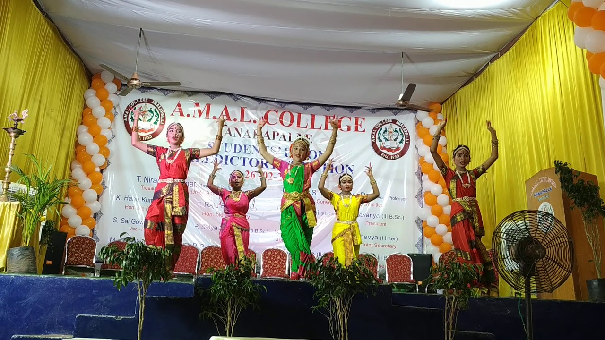
Anchor 1: We are very fortunate to have the Honorable chief guest, Mr. Shrikant Gaikwad, with us. He is an I.F.S officer and alumnus of our school.
Anchor 2: Now I request the Honorable Chief Guest to say a few words and motivate our students. (Chief Guest Speech)

Slide 7
C.1) Polio immunization
The best way to protect against polio, or poliomyelitis, is to get vaccinated. Polio vaccination has been part of the routine childhood immunization schedule in the United States for decades. It's still part of the routine childhood immunization schedule.
Inactivated polio vaccine (IPV) is the only polio vaccine that has been given in the United States since 2000. Oral polio vaccine (OPV) is used in other countries.

Slide 8
As part of routine childhood immunization, children in the United States should get IPV to protect against polio. IPV may sometimes be given in the same shot with other vaccines (also called combination vaccines). You can ask your child's doctor about this option.

Slide 9
Thanks to a successful vaccination program, most people in the United States are protected from polio. However, people who are not vaccinated or who haven't received all recommended doses may be at risk of getting polio. The disease still occurs in other parts of the world. It only takes one person with polio traveling from another country to bring polio into the United States.
Who should get vaccina

Slide 10
As part of routine childhood immunization, all children in the United States should get IPV to protect against polio. This includes children who have not started their polio vaccine series or who are delayed in getting all recommended doses. People who plan to travel internationally should make sure they and their children are fully vaccinated against polio before departure.
Adults

Slide 11
Your or your child’s doctor’s office is usually the best place to receive recommended vaccines. Vaccines may also be available at pharmacies, workplaces, community health clinics, health departments, schools, or religious centers.

